Slide 1
Full Stack Development

Slide 2

What is Full Stack...?
Full Stack developer is someone who is familier with all layers of software development.
These developers aren't expert in everything but simply have the functional knowledge to finish and develop the entire product.
●
●

Slide 3
Front-End Technologies in Full Stack Includes:
  HTML
  CSS
  Javascript
  Bootstrap
Back-End Technologies in Full Stack Includes:
  PHP
Database Technologies in Full Stack Includes:
  MySQL

Slide 4
Web Design with HTML

Slide 5
What is a Web Page ?
“ The basic unit of information displayed over the net is a Web Page”
What is a web site ?
“ A web site is a collection of such web pages ,Which are interlinked which is recognized by URL”

Slide 6
Introduction to HTML
The language used to develop web pages is called
Hypertext Markup Language (HTML).
HTML is the language interpreted by a browser .
Web pages are also called HTML documents.
HTML is a set of special codes that can be embedded in text to add
formatting & linking information .

Slide 7
Structure of HTML code
<HTML>
<HEAD>
…...
</HEAD>
<BODY>
……
</BODY>
</HTML>
Heading Section
Actual Text
Description:
  <html> tag defines we are using html codes
  <head> tag defines the formatting for head of browser.
  <body> tag defines the actual content of web page.
Note: <head> tag is optional part, use when required.

Slide 8
History of the HTML
1992: HTML 1.0, Tim Berners-Lee original proposal
1993: HTML+, some physical layout
1994: HTML 2.0, standard with best features
1995: Non-standard Netscape features
1996: Competing Netscape and Explorer features
1996: HTML 3.2, the Browser Wars end
1997: HTML 4.0, style sheets are introduced
1999: HTML 4.01, we have a winner!
2000: XHTML 1.0, an XML version of HTML 4.01
2001: XHTML 1.1, modularization
2002: XHTML 2.0, simplified and generalized

Slide 9
HTML Tag
Tags are the HTML code words.
Tags are instructions that are embedded directly in to the text of the document .

Slide 10
Types of Tags
  HTML tags can be of two types.
    Paired tags
    Singular tags

Slide 11
Paired Tags
A tag is said to be a paired tag if it , along with a companion tag.
In paired tags, the first tag (<B>) is often called the opening
tag and the second tag (</B>) is called the closing tag.
The opening tag activates the effect and the closing tag turns the effect off.
For example - <HTML>
    </HTML>

Slide 12
Singular Tags
A tag is said to be a singular tag if it ,does not along with a
companion tag.
A singular tag is also called stand-alone tag . This tag does not
require any companion tag.
For example - <BR> ,<HR>

Slide 13
Tag Attributes
Some HTML tags require additional information supplied to them . For instance , when a picture is placed on the
screen , information like the height and width of the picture can be specified.
Additional information supplied to an HTML tag is known as attributes of a tag.
Attributes are written immediately following the tag, separated by a space.
Multiple attributes can be associated with a tag, also separated by a space.

Slide 14
The structure of an HTML program
<HTML>
<HEAD>
<TITLE> Document Title </TITLE>
</HEAD>
<BODY>
Hi!! This is my first web page.
</BODY>
</HTML>

Slide 15
Attributes of <BODY> Tag
BGCOLOR | Changes the default background color to whatever color is specified with this tag. The user can specify a color by name or its equivalent hexadecimal number.
Exam. - | <BODY BGCOLOR = “black” > <BODY BGCOLOR = “#000000” > <BODY BGCOLOR = “rgb(0,0,0)” >
BACKGROUND | Specifies the name of the GIF or JPEG file that will be used as the background of document .
Exam. - | <BODY BACKGROUND = “abc.gif” > <BODY BACKGROUND = “../das.jpeg” > <BODY BACKGROUND = “clouds.gif” >
TEXT | Changes the body text color from its default value to the color specified with this attributes.
Exam. - | <BODY TEXT = “red” >

Slide 16

The structure of an HTML program
<TITLE>….<TITLE>Tag
<BODY>…..</BODY> Tag
<HTML>
<HEAD>
<TITLE>LOOK OF AN HTML DOCUMENT</TITLE>
</HEAD>
<BODY>
“Welcome to the World of HTML”
</BODY>
</HTML>

Slide 17

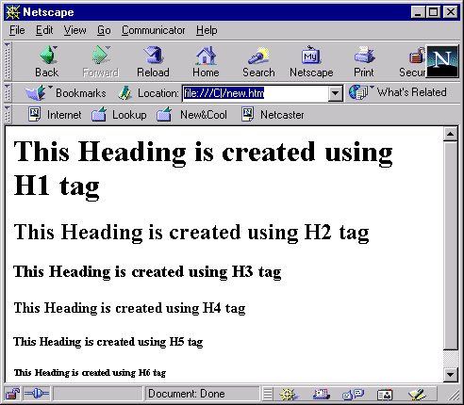
HTML Tags
Syntax
<HTML>
<HEAD>
<H1>……….</H1>
</HEAD>
Headline Tags
Example
<HTML>
<HEAD>
<H1> This Heading is created using H1 tag </H1>
<H2> This Heading is created using H2 tag </H2>
<H3> This Heading is created using H3 tag </H3>
<H4> This Heading is created using H4 tag </H4>
<H5> This Heading is created using H5 tag </H5>
<H6> This Heading is created using H6 tag </H6>
</HEAD>
</HTML>

Slide 18
Paragraph Formatting
Paragraph Tag
<P> ……. </P>
Attributes
  ALIGN Attribute
    CENTER
    LEFT
    RIGHT
Example
<P>
The paragraph
text should be added here within the <P> tag.
</P>

Slide 19
Font Settings Tags
<FONT>……..</FONT> - Used for text Style Specifications
ATTRIBUTES
    FACE
<FONT FACE=”ARIAL”>
PARAGRAPH SPECIFICATION
</FONT>
    Size
<FONT SIZE=”5”>
PARAGRAPH SPECIFICATION
</FONT>
    Color
<FONT COLOR=”Blue”
PARAGRAPH SPECIFICATION
</FONT>

Slide 20
The <DIV> Tag
DIV Tag -Used for applying alignment and style characteristics to only a section of a document.
DIV Attribute
  Align
    CENTER
    LEFT
    RIGHT
  Syntax
  <DIV
  ALIGN=”Value”
  TEXT
  </DIV>

Slide 21
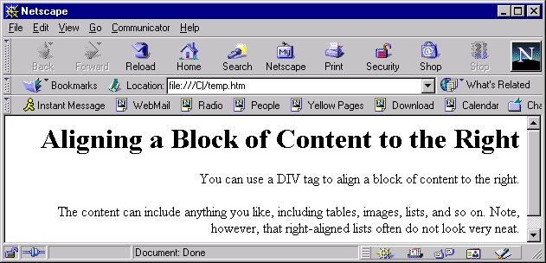
An Example of <DIV> Tag
  <HTML>
  <BODY>
  <DIV ALIGN=RIGHT>
  <H1>Aligning a Block of Content to the Right</H1>
  <P>You can use a DIV tag to align a block of content to the right.</P>
  <P>The content can include anything you like, including tables, images, lists, and so on. Note, however, that right-aligned lists often do not look very neat.</P>
  </DIV>
  </BODY>
  </HTML>

Slide 22
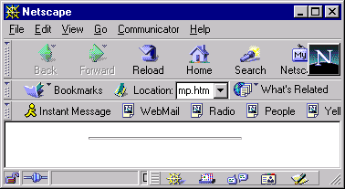
Horizontal Line
<HR> Tag
  Attributes
    WIDTH
    SIZE
Syntax
  <HR>
  Paragraph Specification
  <HR>
Example
Width Attribute
  <HR WIDTH = “50%” >
Size Attribute
  <HR SIZE = “4” >

Slide 23
Text Formatting
Tag Name | Description
<B> | Defines Bold text
<I> | Defines Italic text
<U> | Defines Underline text
<BIG> | Defines Big text
<SMALL> | Defines Small text
<SUB> | Defines Subscripted text
<SUP> | Defines Superscripted text
<STRONG> | Defines Strong text
<INS> | Defines Inserted text
<DEL> | Defines Deleted text

Slide 24
Character Entities
Some characters have a special meaning in HTML, called character entities.
If we want the browser to actually display these characters we must insert character entities in the HTML code.
A character entity has three parts :
  An ampersand (&)
  An entity name
  OR
  # and entity number
  A semicolon ( ;)

Slide 25
Character Entities
RESULT | DESCRIPTION | ENTITY NAME
 | Non-breaking space | &nbsp;
< | Less than | &lt;
> | Greater than | &gt;
& | Ampersand | &amp;
“ | Quotation mark | &quot;
‘ | Apostrophe | &apos;
¢ | Cent | &cent;
£ | Pound | &pound;
¥ | Yen | &yen;
§ | Section | &sect;
© | Copyright | &copy;
® | Registered Trademark | &reg;
× | Multiplication | &times;
÷ | Division | &divide;

Slide 26
MARQUEE Tag
The HTML <marquee> tag is used for scrolling piece of text or image displayed either horizontally across or vertically down your web site page depending on the settings.

Slide 27
Marquee Attributes:
Attribute | Value | Description
behavior | scroll slid alternate | Defines the type of scrolling.
bgcolor | #xxxxxx colorname | Deprecated - Specifies the background color.
direction | Up , down left , right | Defines the direction of scrolling the content.
height | pixels or % | Defines the height of marquee.
hspace | pixels | Specifies horizontal space around the marquee.
loop | number | Specifies how many times to loop. The default value is INFINITE, which means that the marquee loops endlessly.
scrolldelay | seconds | Defines how long to delay between each jump.
scrollamount | number | Defines how how far to jump.
width | pixels or % | Defines the width of marquee.
vspace | pixels | Specifies vertical space around the marquee.

Slide 28
Adding Images
Inline Image - The images are generally in one of the two formats – GIF (Graphic Interchange Format) or JPEG (Joint Photographic Experts Group).
  Syntax
  <IMG SRC=“image.gif”>

Slide 29
Special Effect Tags
Attributes | Description
ALIGN | Controls alignment of the text following the image. Exam. – ALIGN = TOP
BORDER | Specifies the size of the border to place around the image.
WIDTH | Specifies the width of the image in pixels.
HEIGHT | Specifies the height of the image in pixels.
HSPACE | Indicates the amount of space to the left & right of the image.
VSPACE | Indicates the amount of space to the top and bottom of the image.
ALT | Indicates the text to be displaced in case the browser is unable to display the image specified in the SRC attribute.

Slide 30
Lists - Group of Items
List is a list of items. The list is categorized in to three categories.
  Ordered List
  Unordered List
  Definition List

Slide 31
Example of Ordered List
Name of cities :
<OL TYPE = “1” START = 4>
<LI> Delhi
<LI> Agra
<LI> Bangalore
</OL>
Output
Name of cities :
4 Delhi
5 Agra
6 Bangalore

Slide 32
Unordered List
An unordered List starts with the tag <UL> and end with </UL>.
Each list items start with the tag <LI>. The attributes of <LI> are –
Attributes
    TYPE =
      CIRCLE
      DISC
      SQUARE

Slide 33
Example of Unordered List
<UL>
  <LI>Monday
  <LI>Tuesday
  <LI>Wednesday
  <LI>Thursday
  <LI>Friday
</UL>
Output
  Monday
  Tuesday
  Wednesday
  Thursday
  Friday

Slide 34
Definition Lists
Definition list start with the tag <DL> and end with the tag /DL>.
Definition List has two sub tags.
      Definition term <DT>
      Definition Description <DD>

Slide 35
Example of Definition List
<DL>
<DT> Keyboard
<DD> An Input Device
<DT> Printer
<DD> An Output Device
</DL>
Output
Keyboard
An Input Device
Printer
An Output Device

Slide 36
Anchors
  The HTML <a> tag is used for creating a hyperlink to either another document, or somewhere within the current document.
  <A>…….</A>
  HREF Attributes
    Syntax
      <A HREF=”URL”>
  Text-to-Click
  </A>

Slide 37
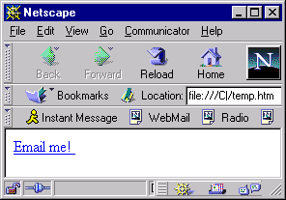
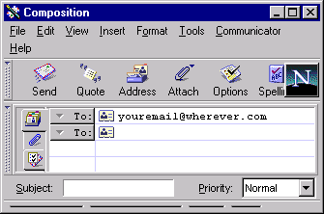
E-Mail Hyperlinks
Syntax
    <A href=“www.gmail.com">Email me!
    </A>
<A href=”mailto:Any EmailID”>

Slide 38
Tables
A table is a two dimensional matrix, consisting of rows and columns.
Tables are intended for displaying data in columns on a web page.
All table related tags are included between the <TABLE> and </TABLE>.
Each row of a table is described between the <TR> and </TR>.
Each column of a table is described between the <TD> and </TD>.

Slide 39
Table Tags
The attributes of <TABLE> tag are :
Attributes | Description
ALIGN | Horizontal alignment is controlled by the ALIGN attribute. It can be LEFT,CENTER or RIGHT.
VALIGN | Controls the vertical alignment of cell contents. It accepts the values TOP, MIDDLE or BOTTOM.
WIDTH | Sets the WIDTH to a specific number of pixels or to a percentage of the variable screen width . The data cell is adjusted based on the cell data value.
BORDER | Controls the border to be placed around the table. The border thickness is specified in pixels.
CELLPADDING | This attribute controls the distance between the data in a cell and the boundaries of the cell.
CELLSPACING | Controls the spacing between adjacent cells.

Slide 40
Table tags
The attributes of <TABLE> tag are :
Attributes | Description
COLSPAN | The COLSPAN attribute inside a <TH> or <TD> tag instructs the browser to make the cell defined by the tag to take up more than one column. The attribute can be set by giving a numeric value . Exam. COLSPAN = 2
ROWSPAN | The ROWSPAN attribute works in the same way as the COLSPAN attribute except that it allows a cell to take up more than one row. Exam ROWSPAN = 3

Slide 41
Table tags
Header Rows ( A row that spans across columns of a table)
  A table header row is defined using <TH></TH> tags.
  The content of a table header row is automatically centered and appears in boldface.
Data rows ( Individual data cells placed in the horizontal plane creates a data row )
  There could be a single data cell or multiple data cells.
  Data cells hold data that must be displayed in the table.
  A data row is defined using <TR></TR> tags.

Slide 42
Forms
An HTML form is a section of a document containing normal content, markup, special elements called controls and labels on those controls.

Slide 43
Controls
A control's "control name" is given by its name attribute.
Each control has both an initial value and a current value,both of which are
character strings.
The control's "current value" is first set to the initial value

Slide 44
Form Tag
The <form> tag is used in conjunction with form-associated elements. To create
a form, you can nest form-associated elements inside the opening/closing
<form> tags.

Slide 45
Form-Associated Elements
<input>
<textarea>
<button>
<select>
<optgroup>
<fieldset>
<lable>

Slide 46
Attributes for Form tag:
Attribute | Description
action | Specifies a URI/URL of the page that will process the form.
method | Specifies the HTTP method to use when the form is submitted. Possible values:
enctype | Specifies the content type used to encode the form data set when it's submitted to the server. Possible values: application/x-www-form- urlencoded (default) multipart/form-data (use this when uploading files)
accept-charset | Specifies a list of character encodings that the server accepts. The default value is "UNKNOWN".
accept | Specifies a comma-separated list of content types that the server accepts.

Slide 47
Benefits of HTML
HTML is a simple but powerful formatting language to use.
The Web pages can be linked together using links.
HTML documents are device independent.

Slide 48
Limitations of HTML
No programming capabilities
Does not provide anything more than formatted text, pictures and sound

Slide 49
An introduction to Cascading Style Sheets
CSS is the acronym for: ‘Cascading Style Sheets.
CSS is an extension to basic HTML that allows you to style your web pages.
CSS work on only property: value

Slide 50
Applying CSS
There are three ways to apply CSS to HTML
In-line CSS
Internal CSS
External CSS

Slide 51
In-line CSS
In-line styles are plonked straight into the HTML tags using the style attribute.
Example
<p style=“color : red”>This is my CSS Tag</p>
This will make that specific paragraph red

Slide 52
Internal CSS
Embedded, or internal styles are used for the whole page. Inside the head tags, the style tags surround all of the styles for the page.
<style type="text/css">
p { color: red; }
a { color: blue; }
</style>
This will make all of the paragraphs in the page red and all of the links blue.

Slide 53
External CSS
External styles are used for the whole, multiple-page website. There is a separate CSS file.
Make a CSS fie Web.css.
p { color: red; }
Link the css file in your html document.
<link rel="stylesheet" type="text/css" href="web.css" />

Slide 54
CSS Selectors, Properties, and Values
HTML has tags, CSS has 'selectors'. Selectors are the names given to styles in internal and external style sheets.
each selector there are 'properties' inside curly brackets, which simply take the form of words such as color, font-weight or background-color.
A value is given to the property following a colon (NOT an 'equals' sign) and semi-colons separate the properties.

Slide 55
Example
body {
font-size:2px;
color: navy; }
This will apply the given values to the font-size and color properties to the body selector.

Slide 56
Text Properties
Property | Description | Values
color | Sets the color of a text | RGB, hex, keyword
line-height | Sets the distance between lines | normal, number, length, %
letter-spacing | Increase or decrease the space between characters | normal, length
text-align | Aligns the text in an element | left, right, center, justify
text-decoration | Adds decoration to text | none, underline, overline, line-through
text-indent | Indents the first line of text in an element | length, %
text-transform | Controls the letters in an element | none, capitalize, uppercase, lowercase

Slide 57
Border Properties
Property | Description | Values
border | Sets all the border properties in one declaration | border-width, border-style, border-color
border-bottom | Sets all the bottom border properties in one declaration | border-bottom-width, border-bottom-style, border-bottom-color
border-bottom-color | Sets the color of the bottom border | border-color
border-bottom-style | Sets the style of the bottom border | border-style
border-bottom-width | Sets the width of the bottom border | border-width
border-color | Sets the color of the four borders | color_name, hex_number, rgb_number, transparent, inherit
border-left | Sets all the left border properties in one declaration | border-left-width, border-left-style, border-left-color
border-left-color | Sets the color of the left border | border-color
border-left-style | Sets the style of the left border | border-style
border-left-width | Sets the width of the left border | border-width

Slide 58
Chapter Summary
    In this chapter, you have learned:
    HTML stands for “Hyper Text Markup Language”; a markup-language is a collection of markup tags.
    HTML-tags are the keywords of HTML; they are surrounded by angle-brackets (like <html>).
    CSS (Cascading Style Sheet) is used for styling HTML elements.
    Internal CSS uses style (<style>) attribute in the head (<head>) section of the HTML-document.
    External CSS uses separate CSS-file (with extension .css) for styling HTML-elements, and include that file in the head (<head>) section of the HTML-document.

Slide 59
Thank you

